Slide 1

School of Physics
‘$Search for dark matter in the MonoHiggs to b\overline{b}+p_{T}^{miss} final state$’

Slide 2
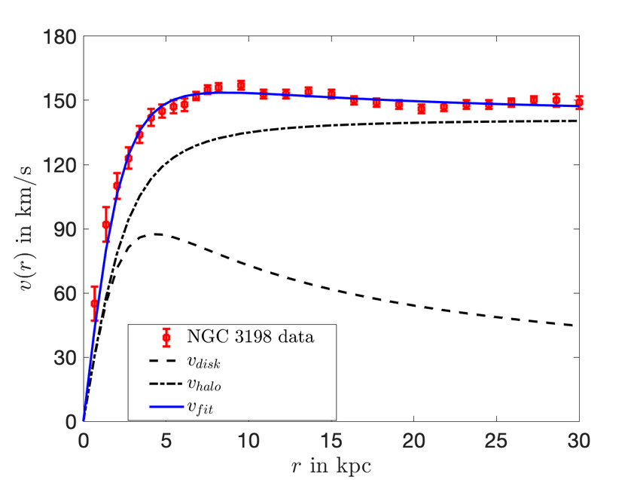
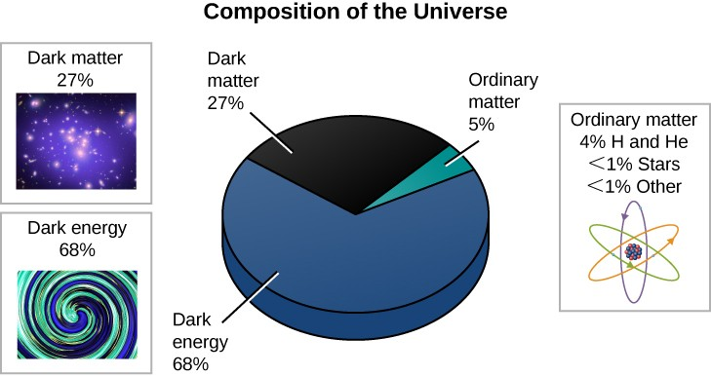
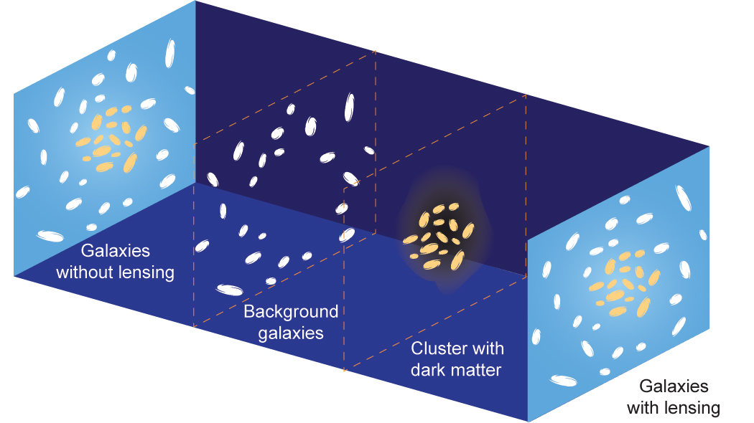
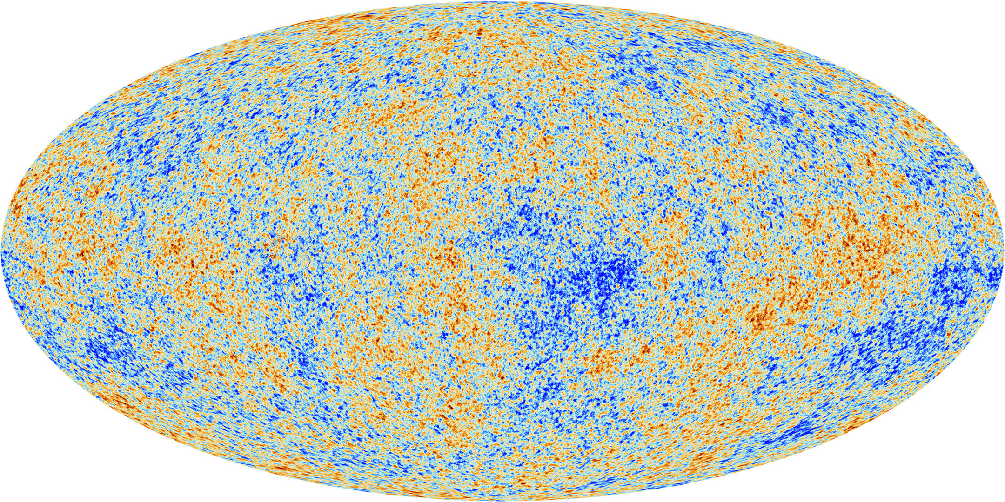
What is Dark matter?
interact only via gravitational interactions
Evidences
Astronomical Evidences
Rotational Curves of Spiral Galaxies
Gravitational Lensing
Cosmological Evidences
CMB
Image : https://courses.lumenlearning.com/suny-geneseo-astronomy/chapter/what-is-the-universe-really-made-of/
Venkataramani, Shankar & Newell, Alan. (2021). Pattern dark matter and galaxy scaling relations.
This Photo by NASA/SSU/Aurore Simonnet is licensed under CC BY-SA-NC
https://www.esa.int/Science_Exploration/Space_Science/Planck/Planck_reveals_an_almost_perfect_Universe
Notes:
Dark Matter seems to interact only via gravitational interactions.
Dark Energy is more mysterious than Dark Matter. It is the result of accounting for the accelerated expansion of the universe.
Ordinary matter is the common Standard Model matter we are all familiar with. It’s the stuff we and the celestial bodies are made of: quarks, leptons, neutrinos, bosons etc.

Slide 3
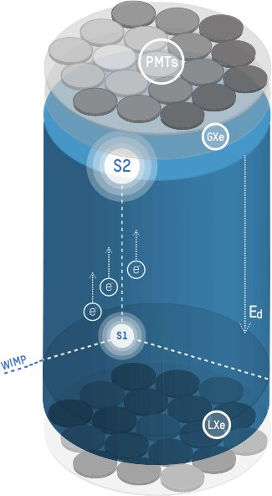
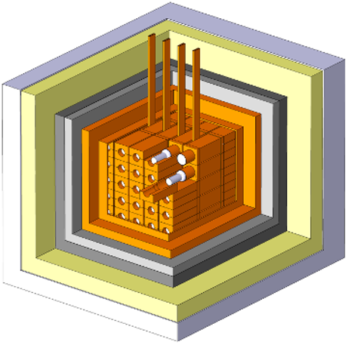
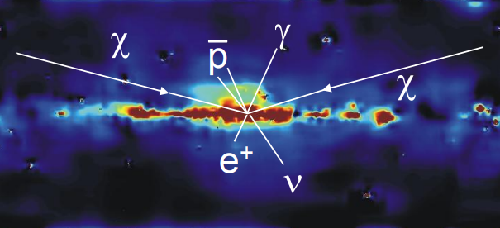
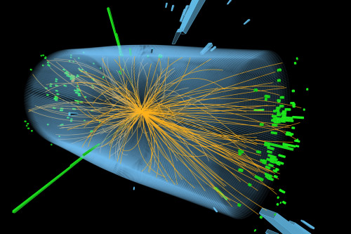
Search for Dark Matter
Indirect
SM
DM
Direct
DM
SM
https://dama.web.roma2.infn.it/?page_id=64
DAMA
XENON Experiment
Collider
Gamma ray observations from the galaxy
Rotation curves of galaxies
Collider searches at CMS

Slide 4
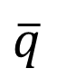

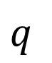

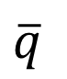
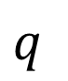
Collider Search: Mono-X Topology
DM
$p_{T}^{miss}$
Back to undetectable dark matter production
DM
(Measurable)
DM
X
(SM particle)
DM
$p_{T}^{miss}$
DM
$$q$$
DM
$$q$$
DM
$$\overline{q}$$
$$\overline{q}$$
DM
X

Slide 5
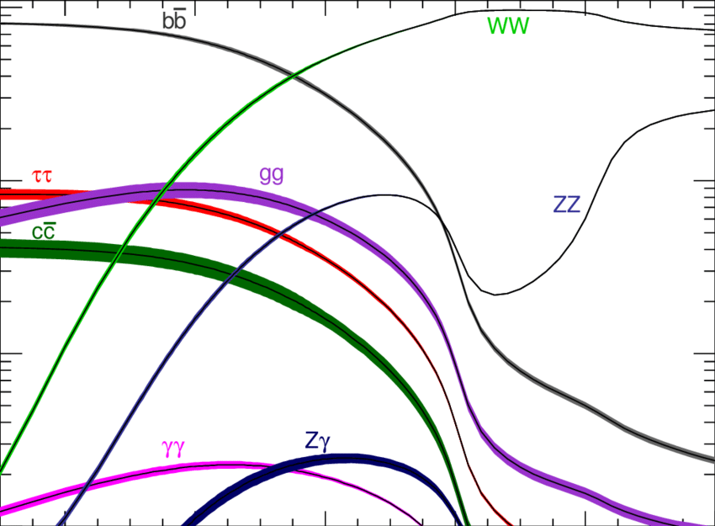
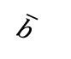
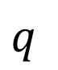

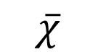
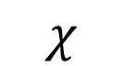
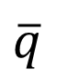
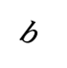
Mono Higgs Searches
No Initial State Radiation
More closely connected to DM production
Signal Signature has a high MET trail which helps to separate the signal from background.
$p_{T}^{miss}$
$$χ$$
$$q$$
$$\overline{χ}$$
H(125)->bb branching ratio is ~ 57%
$$\overline{q}$$
$$\overline{b}$$
h
$$b$$

Slide 6
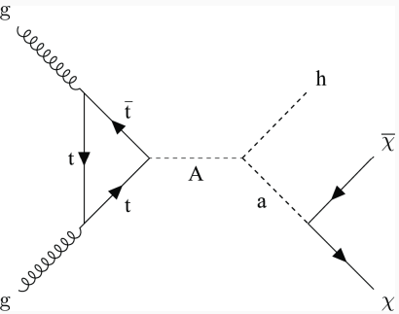
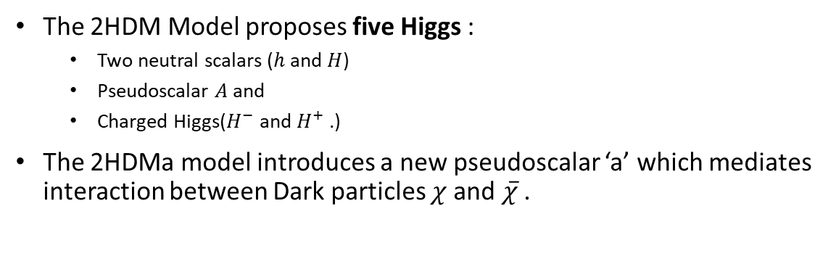

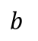
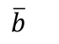
The 2HDMa Model
$$\overline{b}$$
A supersymmetric model to explain dark matter
$$b$$
The 2HDM Model proposes five Higgs :
Two neutral scalars ($h$ and $H$)
Pseudoscalar $A$ and
Charged Higgs($H^{−}$ and $H^{+}$.)
The 2HDMa model introduces a new pseudoscalar ‘a’ which mediates interaction between Dark particles $χ$and $\overline{χ}$ .
The Higgs SM ‘h’ produced can decay through many channels.
One of these channels is the Higgs to two b-quarks.
These b quarks produce jets of particles.
The Dark matter particles go undetected and lead to a large missing momentum.
2HDM = Two Higgs Doublet Model
2HDMa = Two Higgs Doublet Model with a pseudoscalar mediator ‘a’
Final state: $H(\overline{b}b)+p_{T}^{miss}$
Notes:
Paste the definition of ptmiss

Slide 7

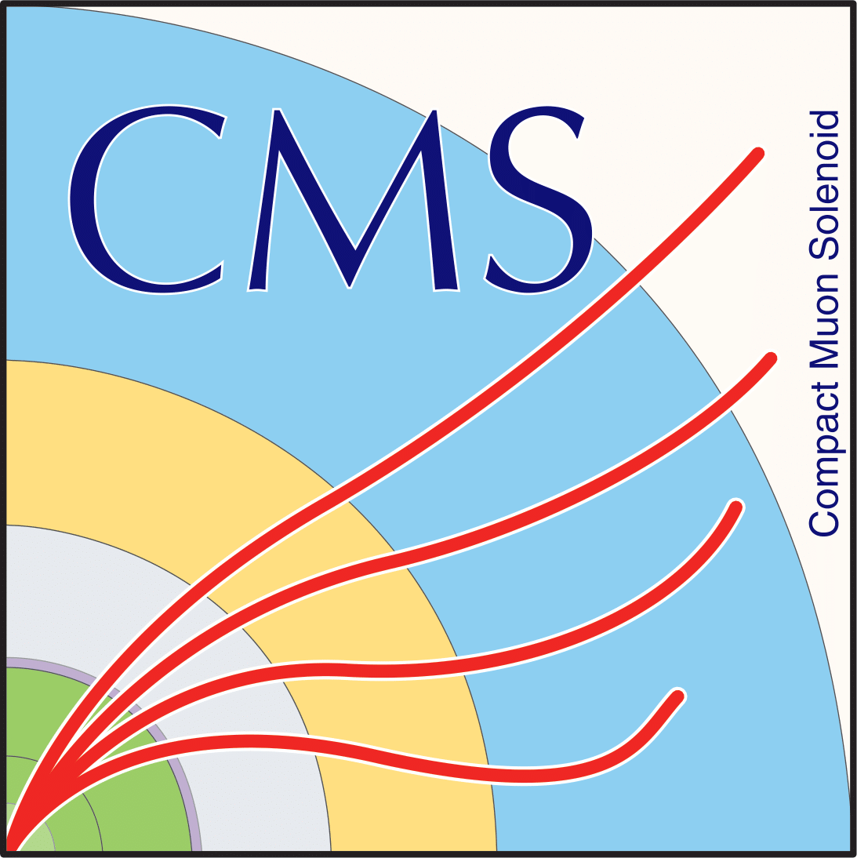
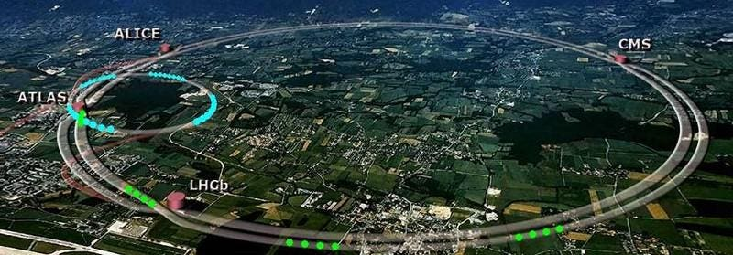
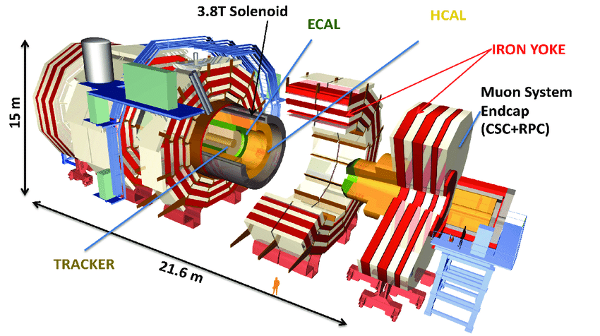
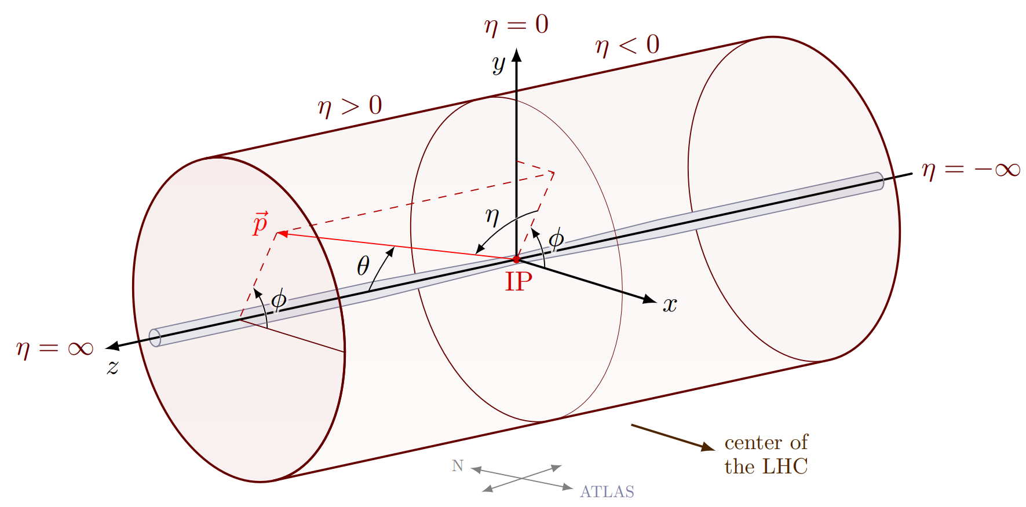
The Large Hadron Collider (LHC)
and the Compact Muon Solenoid (CMS)
Large Hadron Collider (LHC) regulated by the European Organization for Nuclear Research.(CERN)
Proton-Proton collisions happen every 25ns 24/7 .
Based at the French-Swiss border near Geneva.
Two proton beams accelerated to a centre of mass energy of 13.6 TeV are made to collide at four locations.
Detectors surround these four interaction points; these detectors are ALICE, ATLAS, CMS and LHCb .
CMS is a general-purpose detector
CMS uses a powerful solenoid magnet which helped to design the detector in a “compact” form.
Its located 100m underground and provides a good charged particle identification and energy resolution.
Focardi, Ettore. (2012). Status of the CMS Detector. Physics Procedia. 37. 119-127. 10.1016/j.phpro.2012.02.363.

Slide 8
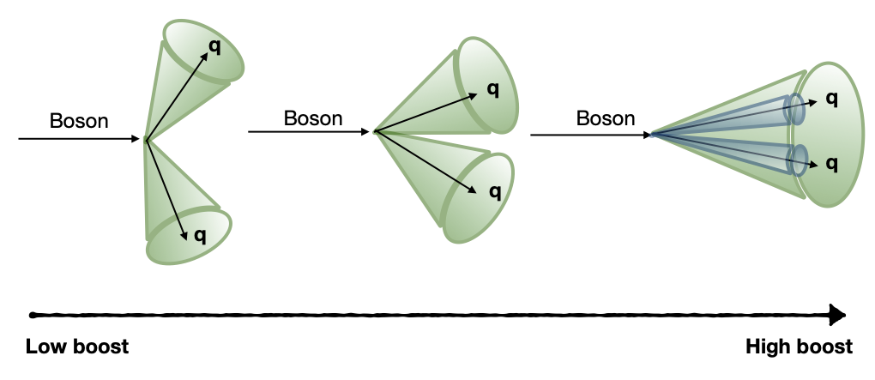
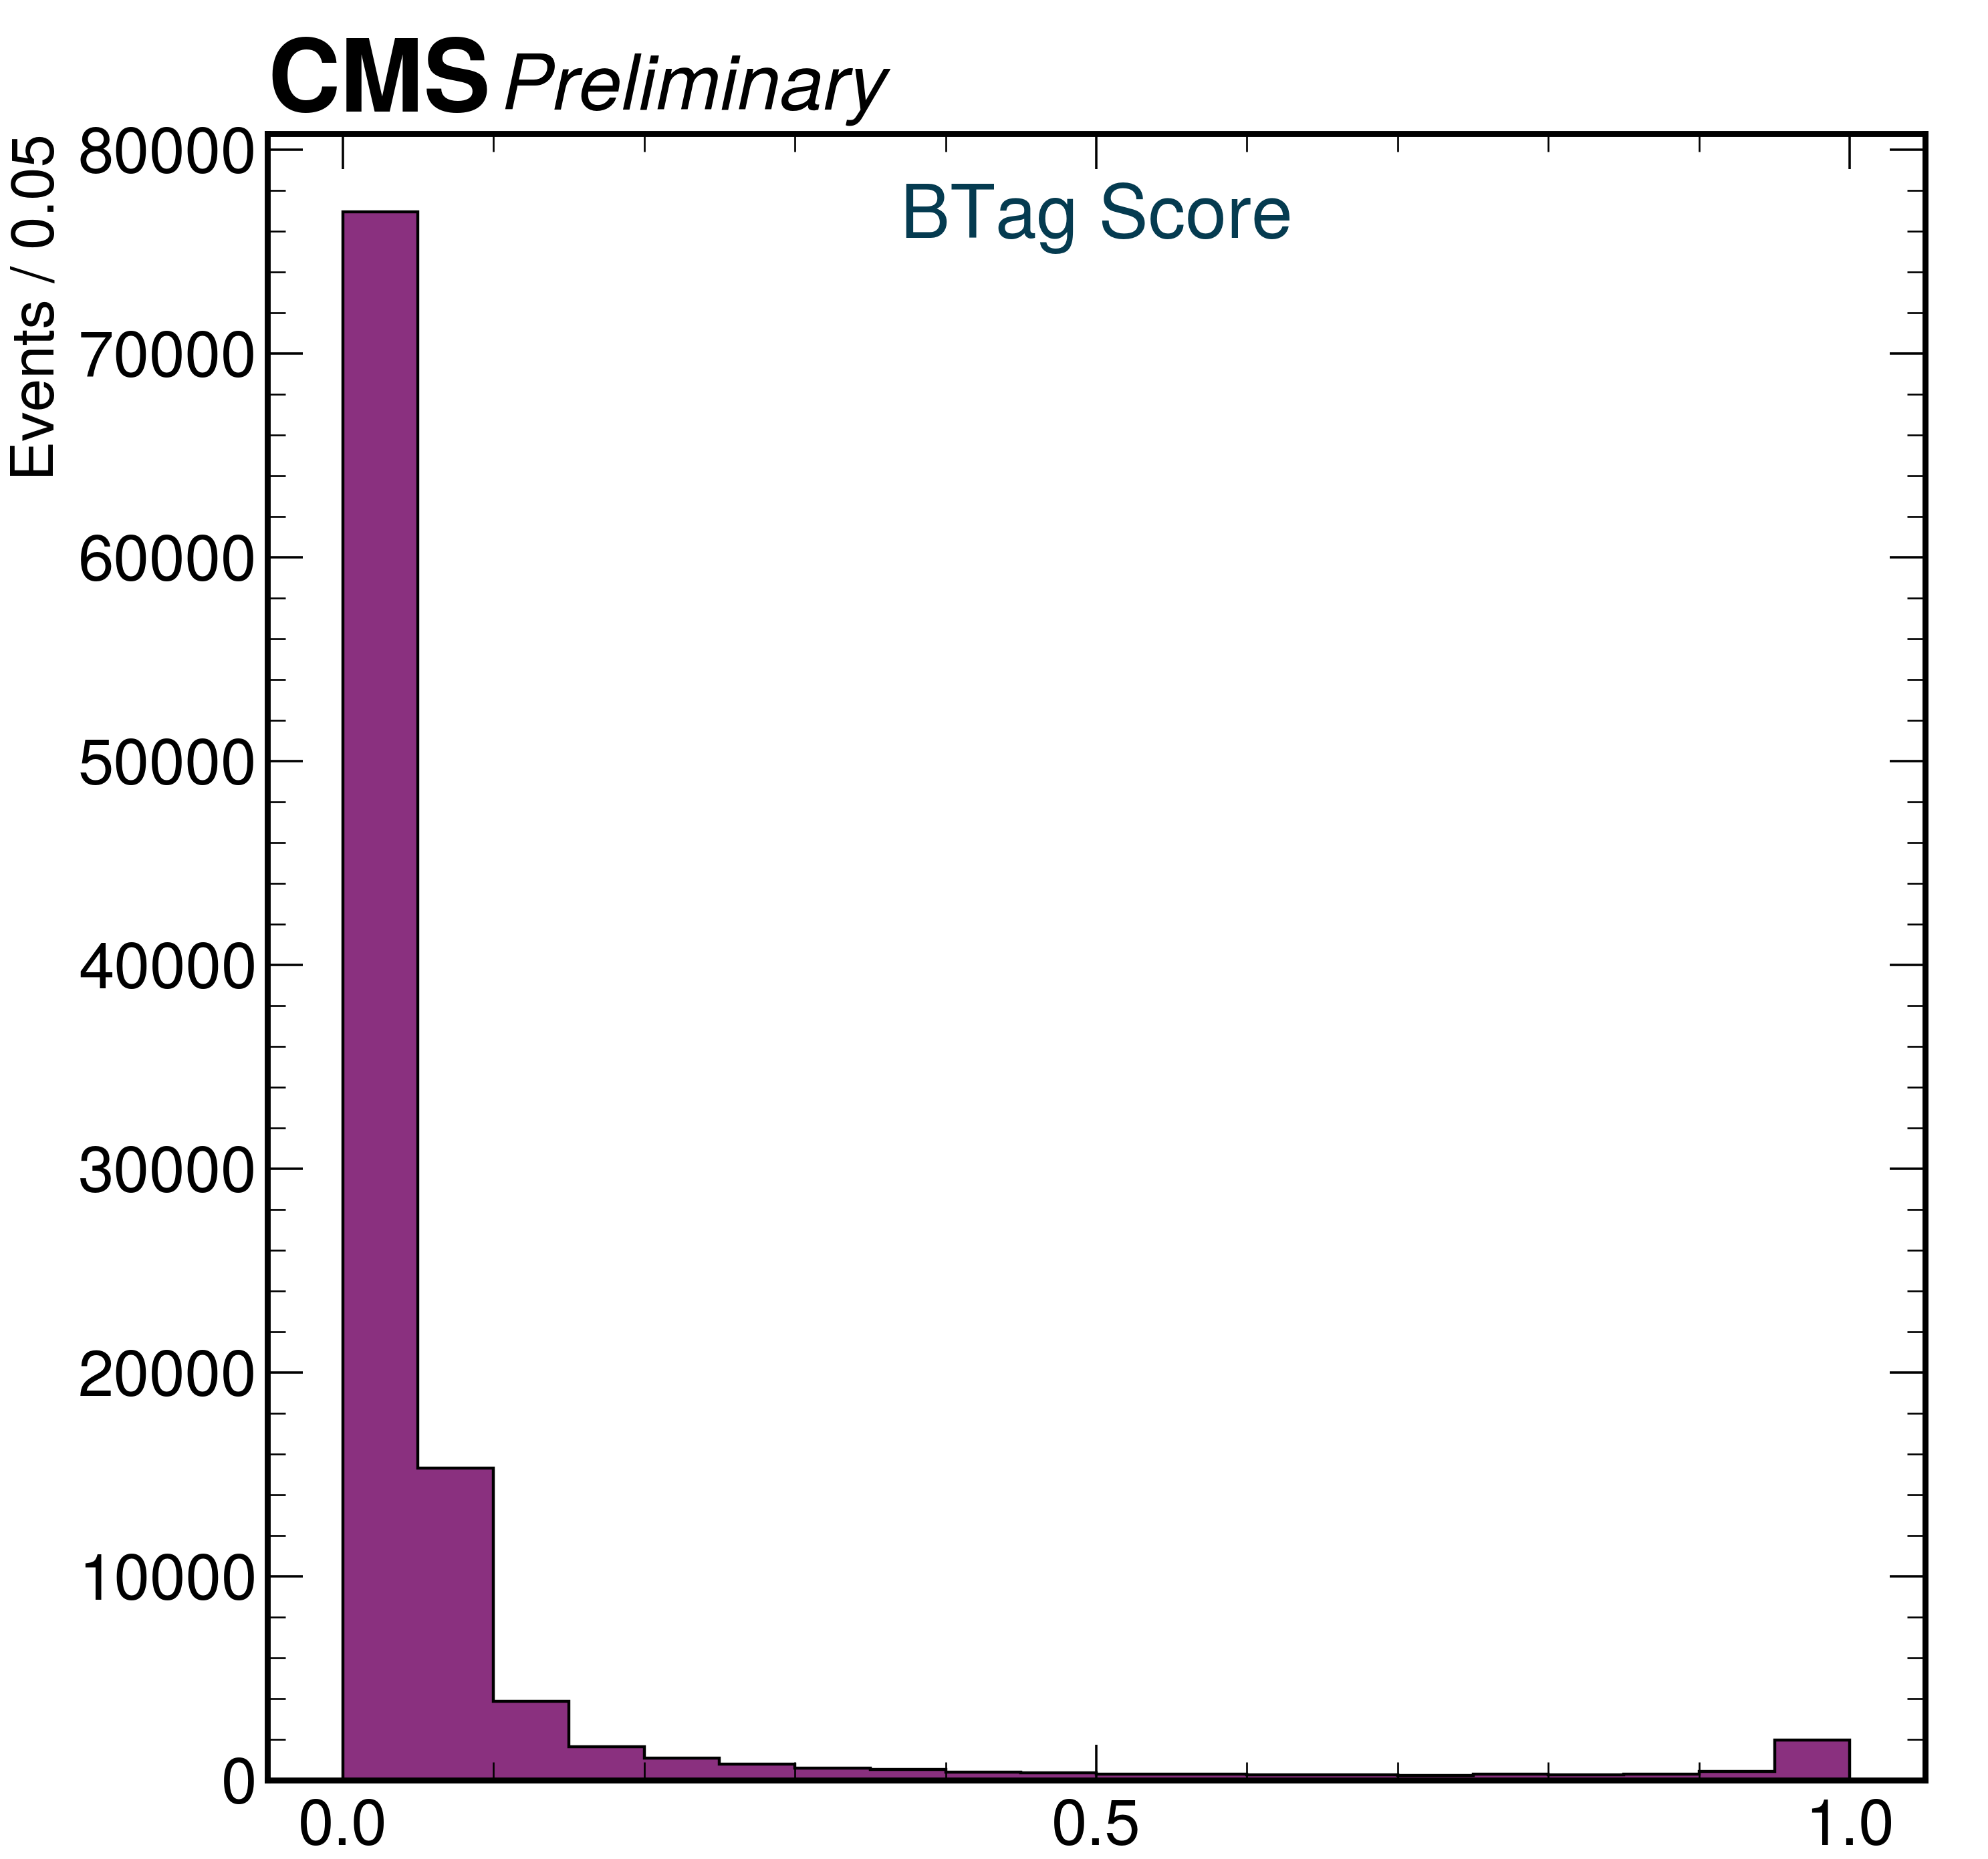
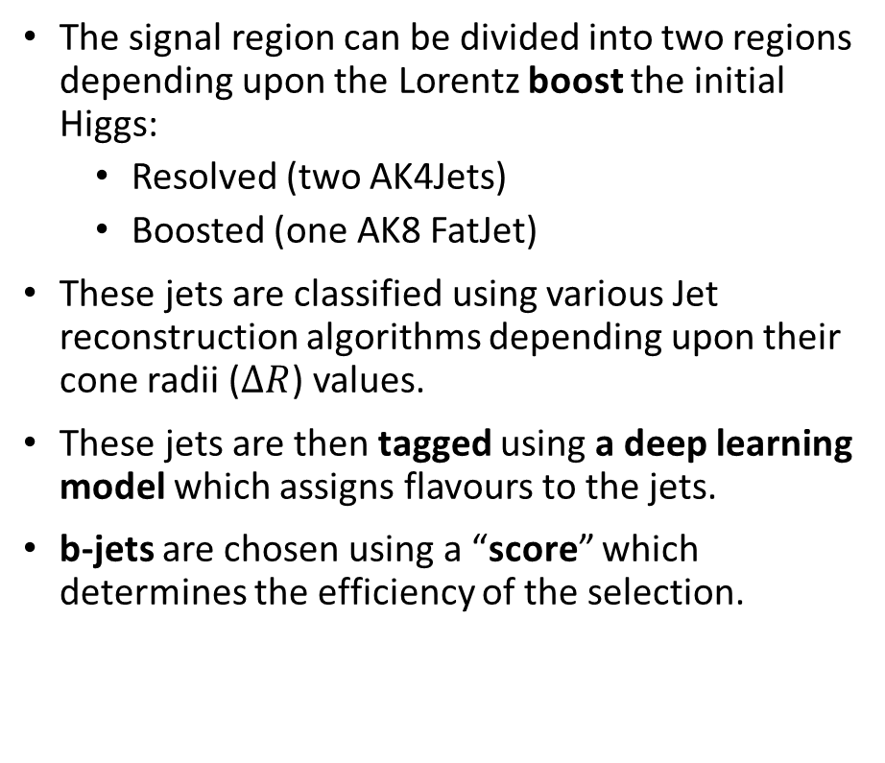
Signal and Background
Resolved
Boosted
The signal region can be divided into two regions depending upon the Lorentz boost the initial Higgs:
Resolved (two AK4Jets)
Boosted (one AK8 FatJet)
These jets are classified using various Jet reconstruction algorithms depending upon their cone radii ($ΔR$) values.
These jets are then tagged using a deep learning model which assigns flavours to the jets.
b-jets are chosen using a “score” which determines the efficiency of the selection.
2018 DATA
1 Million events processed

Slide 9
Signal and Background
The backgrounds which mimic the dijet and missing transverse energy signal are :
Z(νν)+jets
W+jets
Drell-Yan(DY)+jets
Top quark pair production (tt)
Single top production(ST)
The production of the single top quark association with W boson (tW)
Diboson (WW, WZ, ZZ)
The associated production of a Higgs Boson with vector bosons (WH and ZH)
These backgrounds are estimated by using samples generated by Monte Carlo simulation of the reactions.
In addition to background, the 2HDMa(or closely related ZprimeBaryonic) model is also available as a simulated sample.

Slide 10












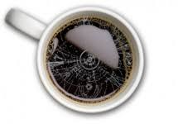
Analysis tools and Strategy
Analysis tools like COFFEA are used. Various other tools in the python ecosystem are routinely employed.
COFFEA is a columnar analysis tools which enables us to deploy scalable and parallel computing ready code for High Energy Physics.
Run 2 data (2018,2017) of CMS is retrieved from the different CERN data tiers.
The data is processed in various compute clusters available at the University of Wisconsin, Madison, USA.
The COFFEA Framework

Slide 11
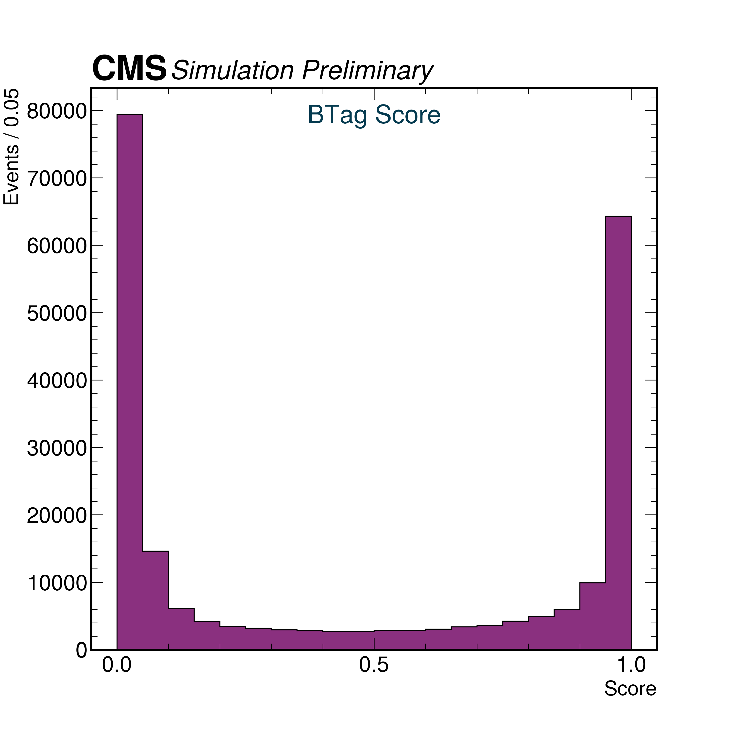

B-Tag Score of all the jets
1 Million events processed
Number of b-jets are a lot less in actual data
Other Jets
b-Jets
Other Jets
b-Jets
Simulated Signal Sample
2018 Data from CMS

Slide 12
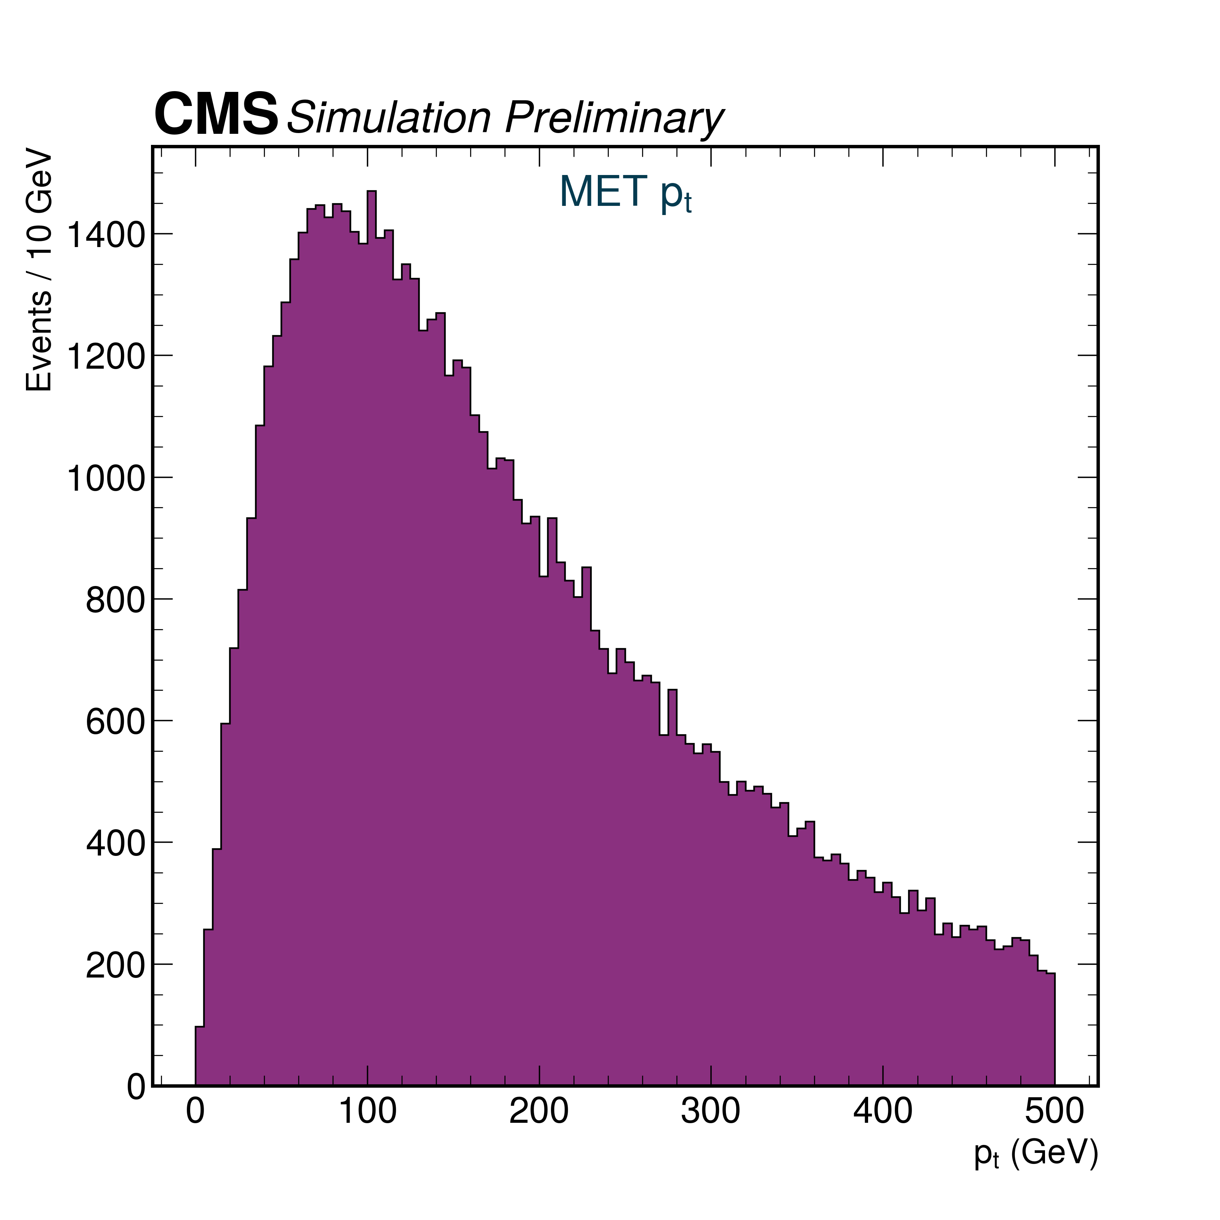
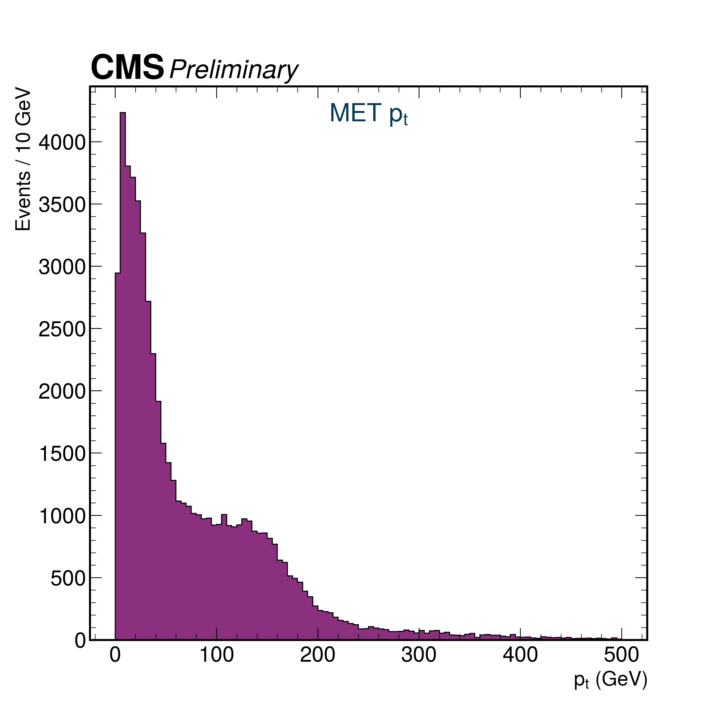
Missing transverse energy (MET) $p_{T}^{miss}$
1 Million events processed
No selections applied
Secondary bumps due to various reasons like QCD background
Simulated Signal Sample
2018 Data from CMS

Slide 13
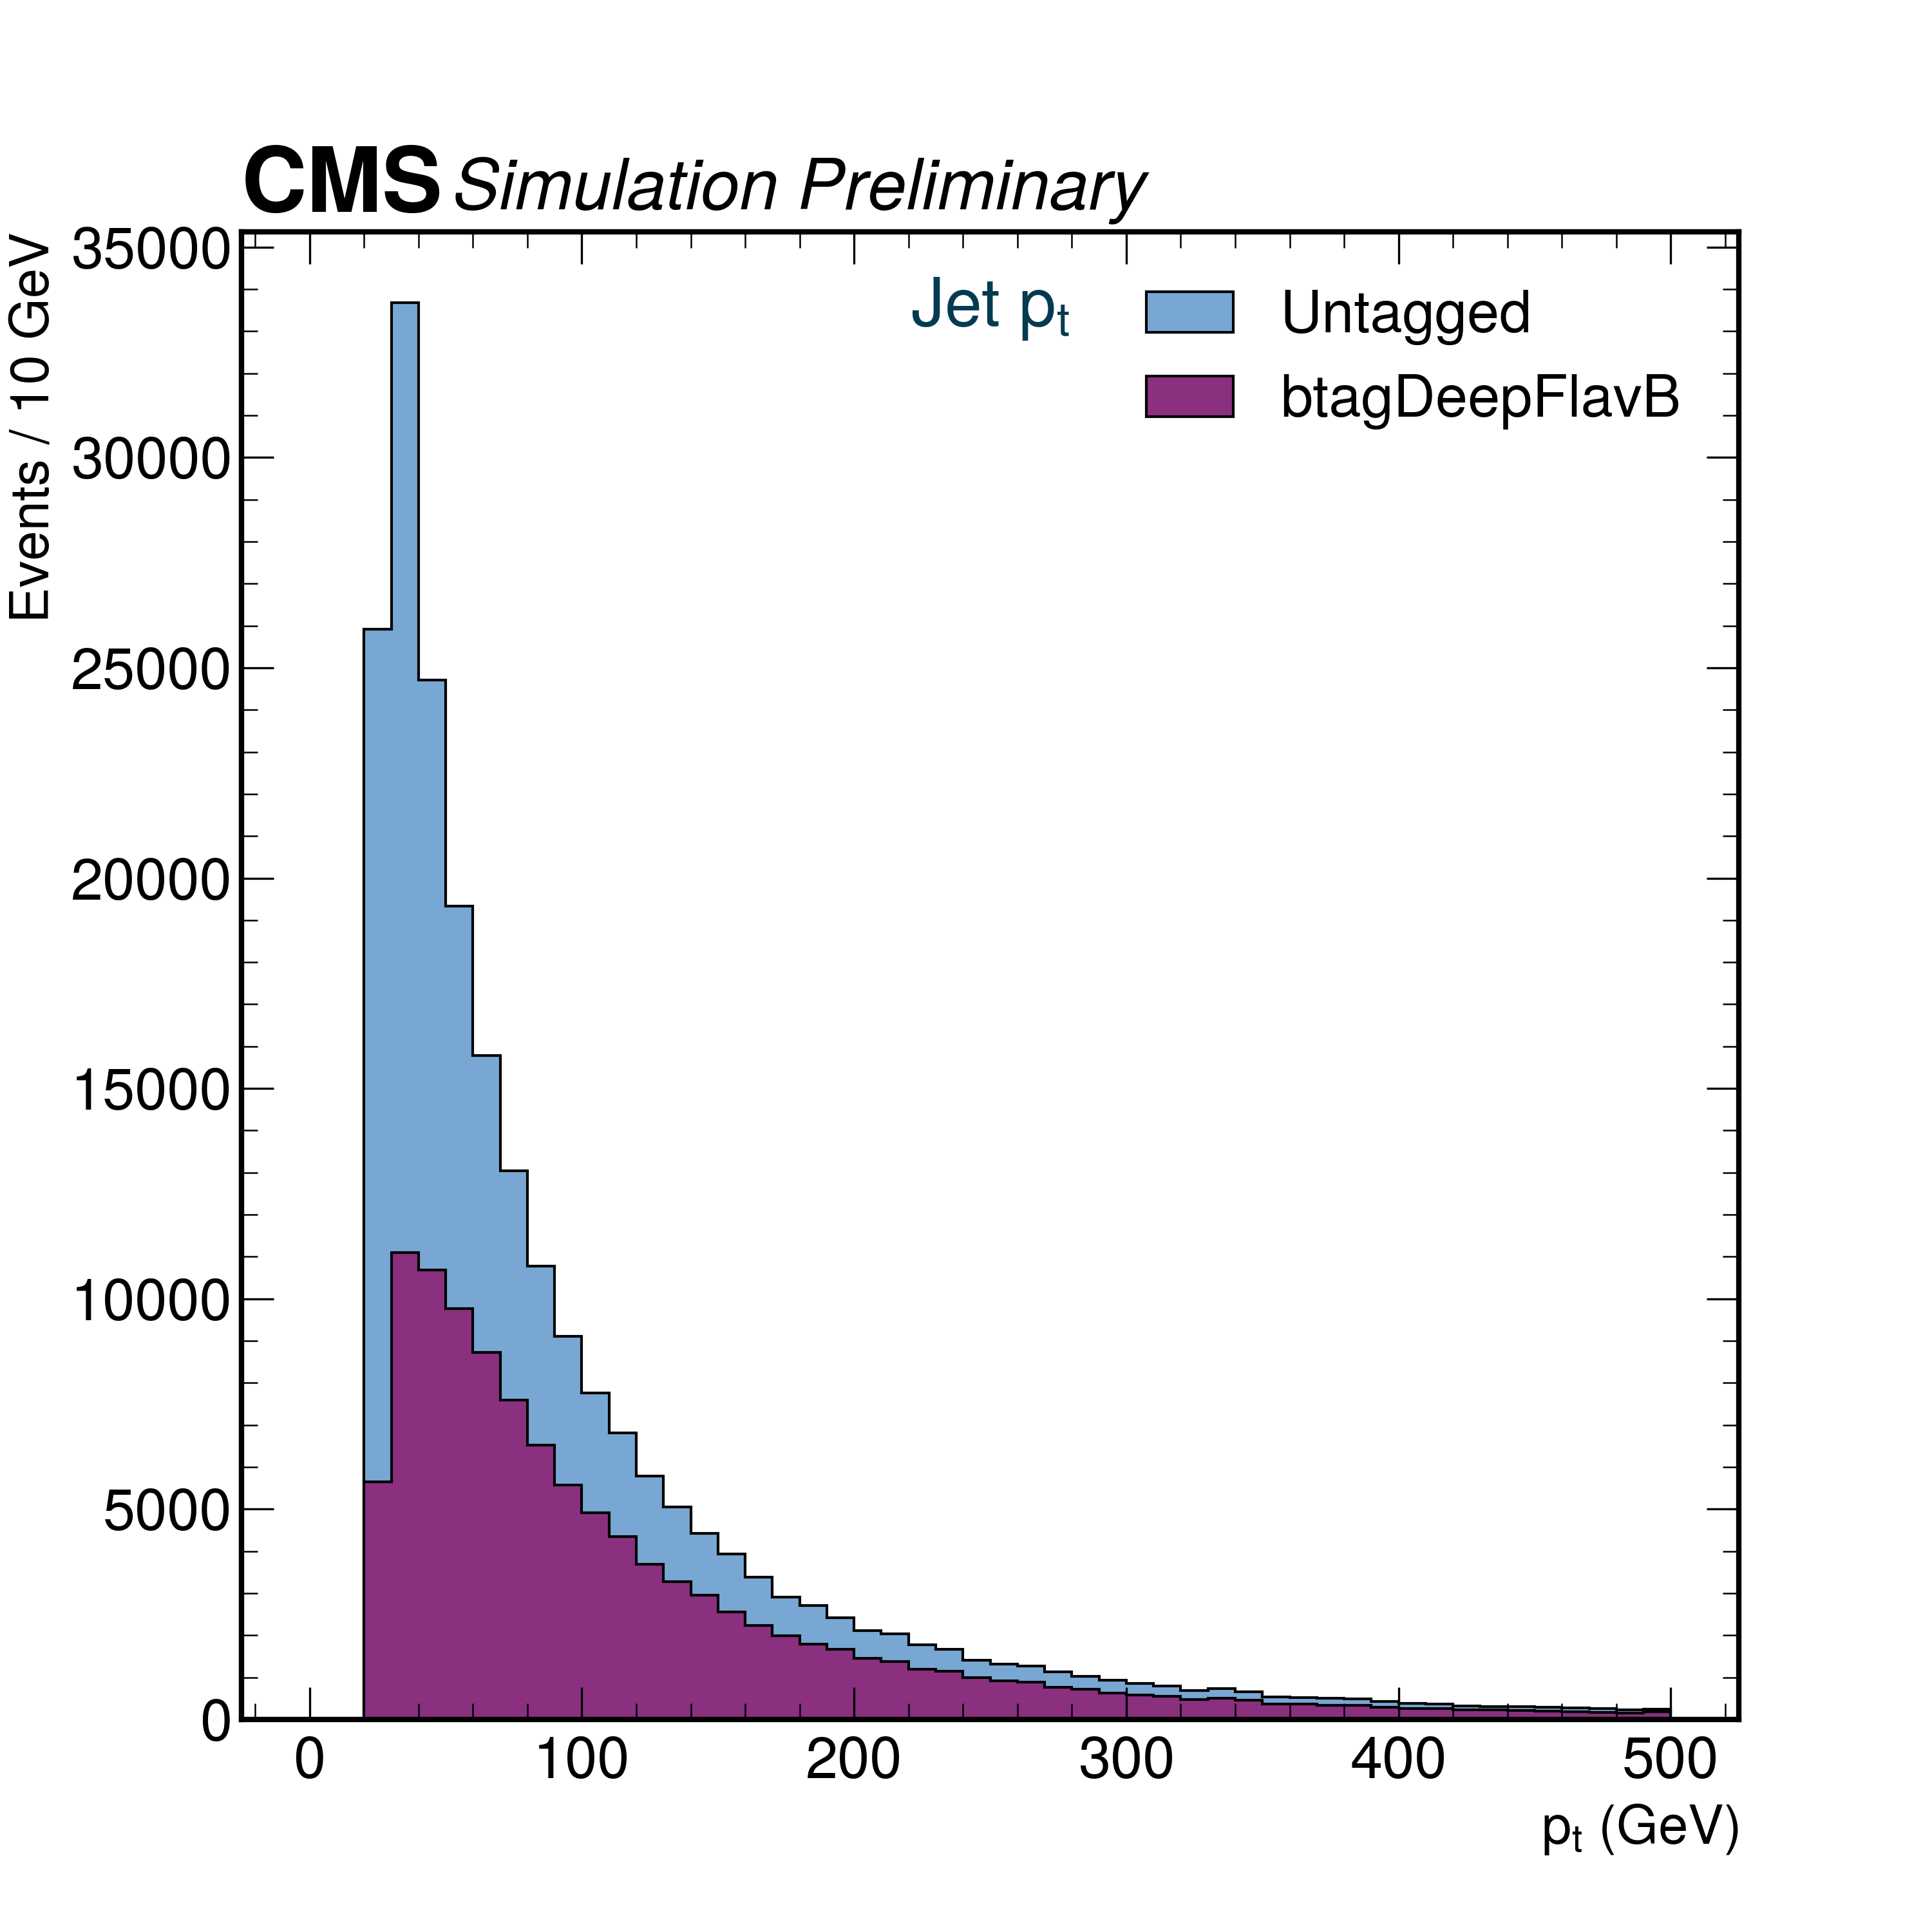
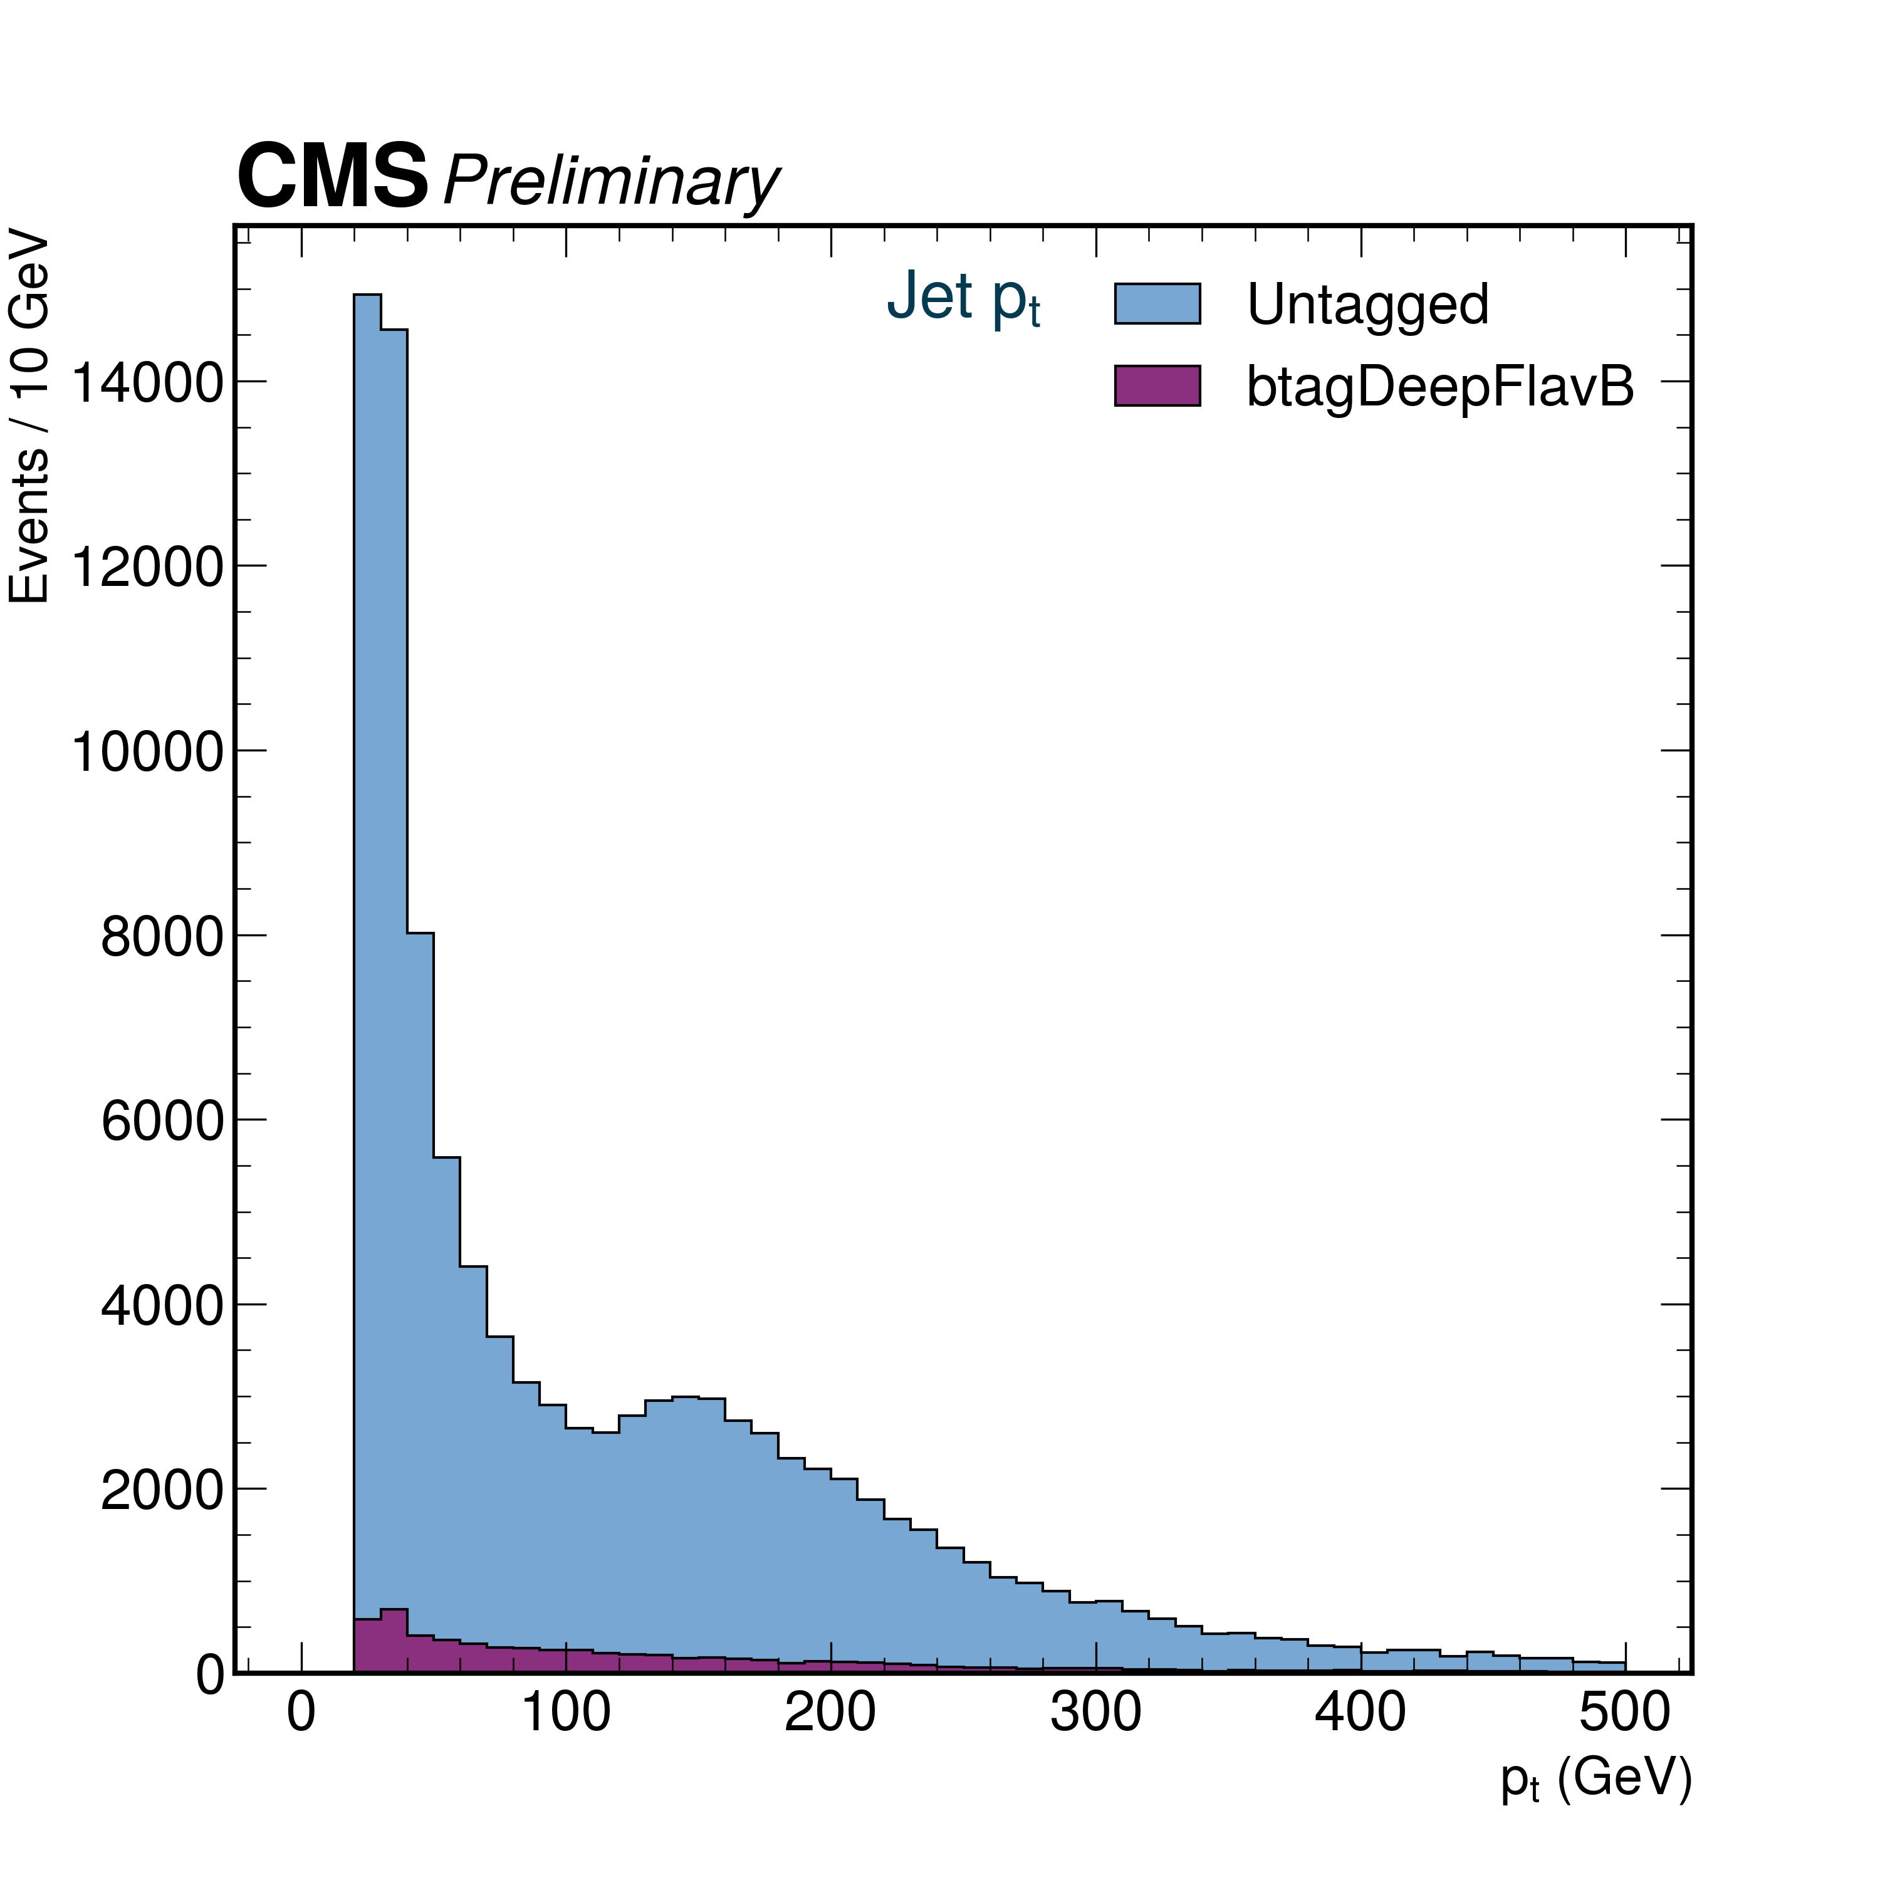
Jet $p_{T}$
1 Million events processed
No selections applied
Secondary bumps due to various reasons like QCD background
Simulated Signal Sample
2018 Data from CMS

Slide 14
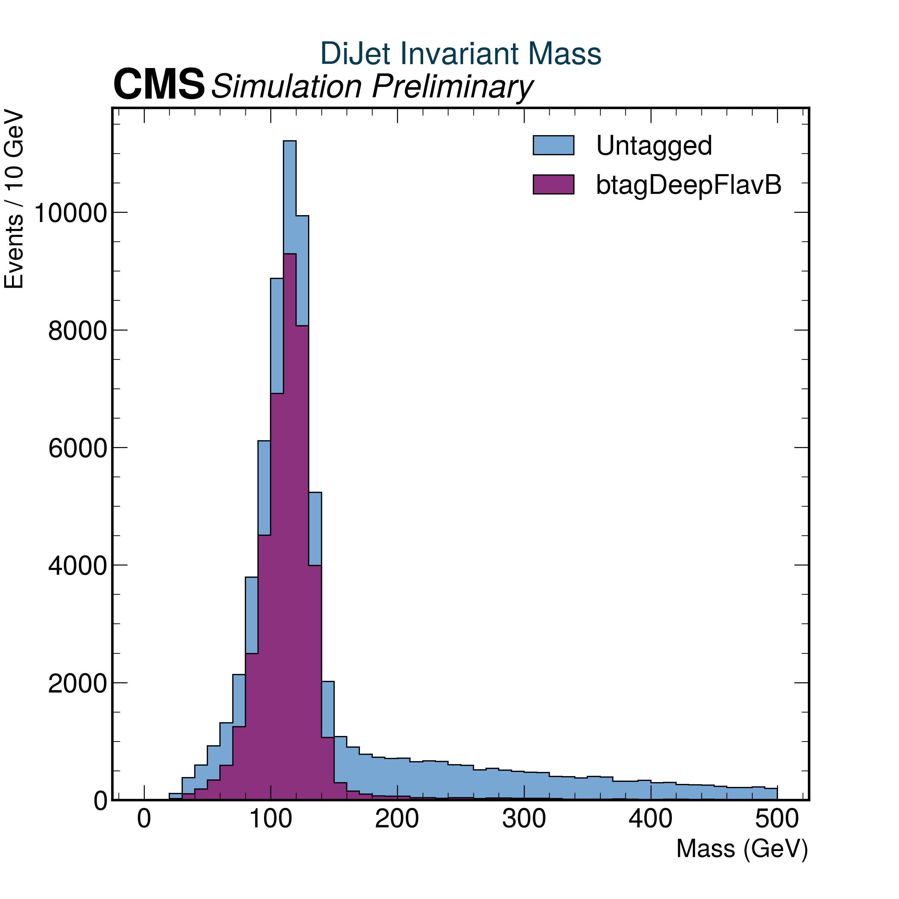
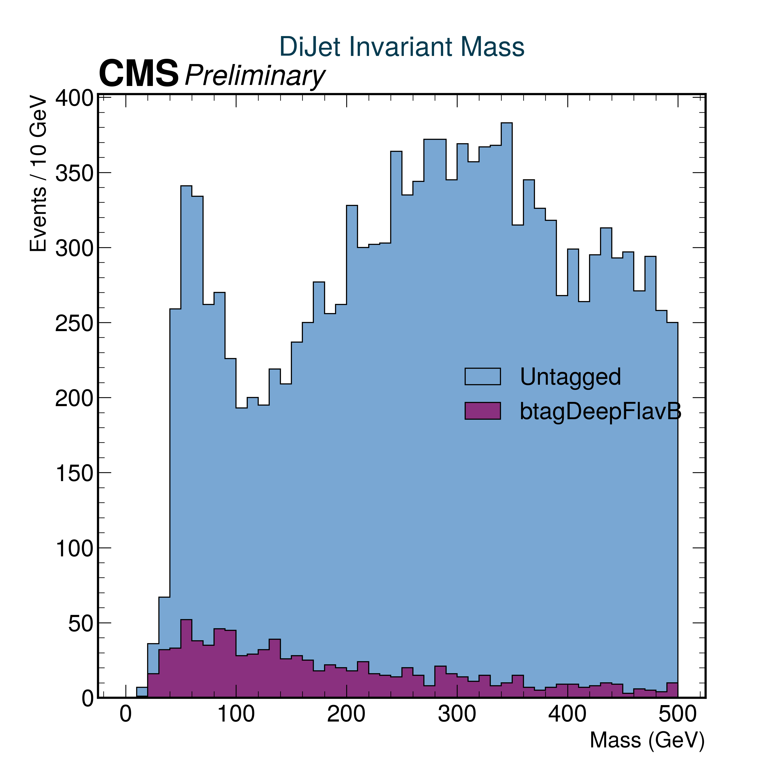
Dijet Invariant Mass
No selections applied
1 Million events processed
Lot of noise in data as expected
Peaks at SM Higgs ~ 125 GeV
Simulated Signal Sample
2018 Data from CMS

Slide 15
Current Status
Apply selection criteria to remove backgrounds from data.
Employing the event selections and object selections for signal region on data and monte-carlo samples.
Estimating the various backgrounds by scaling each of them with their own cross section data, so that I can compare them.
Performing control region studies(getting a hang of it)

Slide 16
Future Aspects
Perform all or some part of control region studies with all the corrections, scaling, refactoring etc.
Perform signal region studies if time permits.

Slide 17
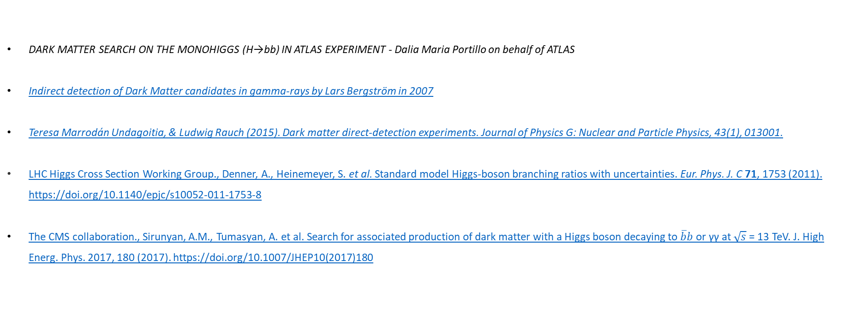
References
DARK MATTER SEARCH ON THE MONOHIGGS (H→bb) IN ATLAS EXPERIMENT - Dalia Maria Portillo on behalf of ATLAS
Indirect detection of Dark Matter candidates in gamma-rays by Lars Bergström in 2007
Teresa Marrodán Undagoitia, & Ludwig Rauch (2015). Dark matter direct-detection experiments. Journal of Physics G: Nuclear and Particle Physics, 43(1), 013001.
LHC Higgs Cross Section Working Group., Denner, A., Heinemeyer, S. et al. Standard model Higgs-boson branching ratios with uncertainties. Eur. Phys. J. C 71, 1753 (2011). https://doi.org/10.1140/epjc/s10052-011-1753-8
The CMS collaboration., Sirunyan, A.M., Tumasyan, A. et al. Search for associated production of dark matter with a Higgs boson decaying to $\overline{b}b$ or γγ at $\sqrt{s}$ = 13 TeV. J. High Energ. Phys. 2017, 180 (2017). https://doi.org/10.1007/JHEP10(2017)180

Slide 18
“No man should escape our universities without knowing how little he knows.” ― J. Robert Oppenheimer

Slide 19
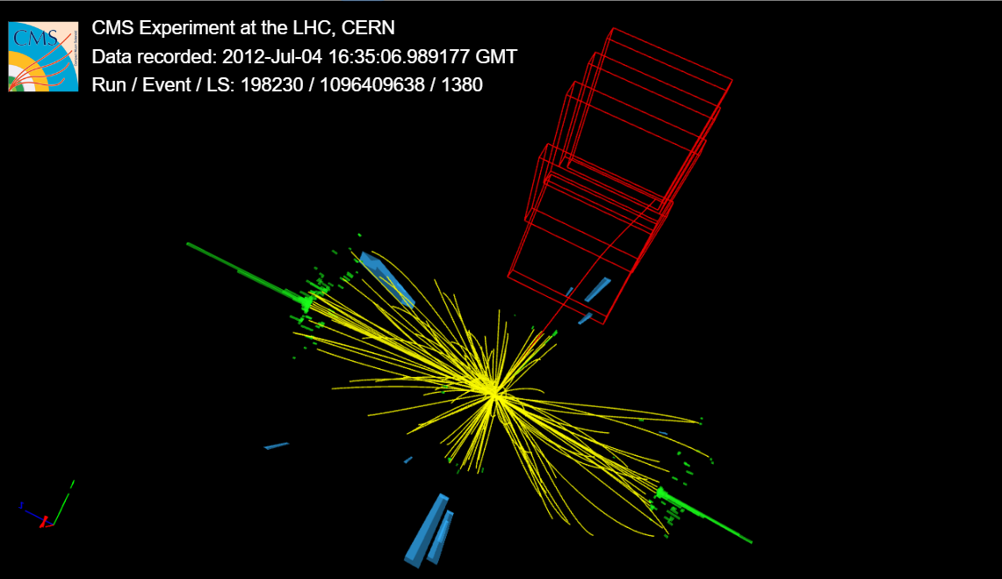
Thank you for your attention.
From iSpyGL , CERN open data

Slide 20
Backup Slides

Slide 21
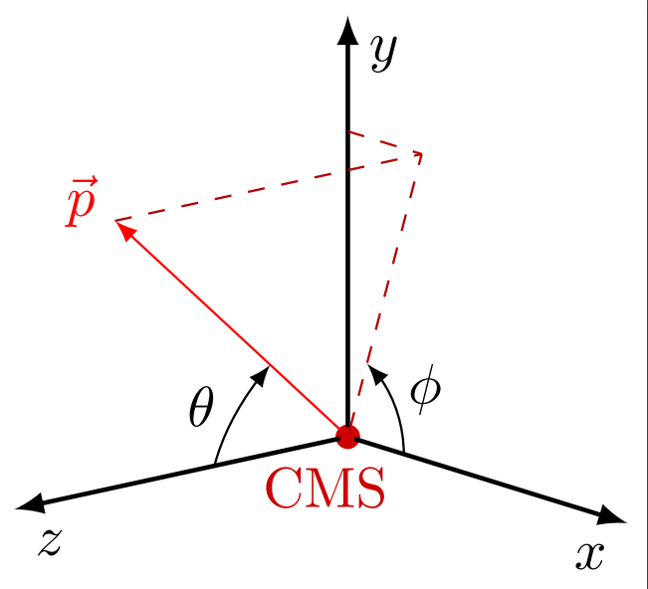
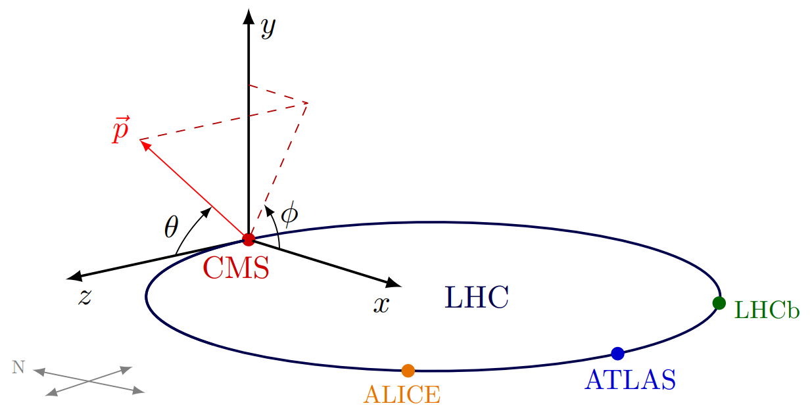
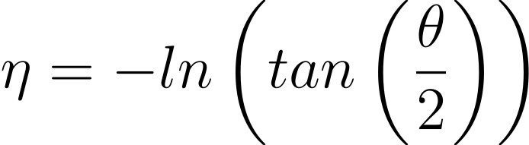
The Coordinate System
The Interaction point(IP) is the origin of the coordinate system.
X direction points to the centre of the LHC ring
Y direction points vertically upwards.
Z direction points towards the western side of beam axis.
The positive angle from the x axis is the azimuthal angle φ .
The positive angle from the z axis is the polar angle θ.
Pseudorapidity is defined as:
https://tikz.net/axis3d_cms/

Slide 22



The Coordinate System
https://tikz.net/axis3d_cms/

Slide 23
Evidences of Dark Matter
Evidences of Dark Matter
Astronomical Evidences
Rotational Curves of Spiral Galaxies
Gravitational Lensing
Cosmological Evidences
CMB

Slide 24
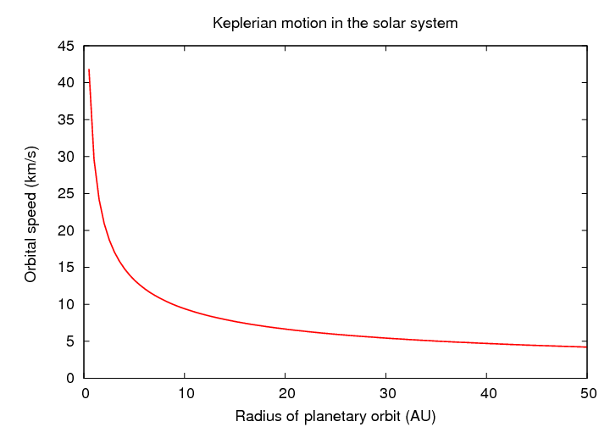
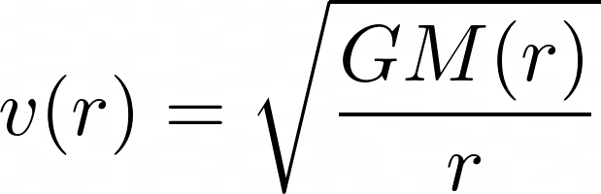
Rotation Curves : Expectation
From Kepler’s law,
is the velocity of a star in the galaxy.
M(r) is the mass of the matter enclosed
inside the disk of radius r.
G is the Universal Gravitational Constant
http://spiff.rit.edu/classes/phys443/lectures/gal_dark/gal_dark.html
Major Feature: Orbital speed decreases as radius of orbit increases

Slide 25
Rotation Curves : Reality
Reality is different
The Orbital speed curve almost becomes horizontal instead of decreasing
Solution : Probably extra mass in galaxy which increases as radius increases
This is the dark matter halo which needs to be considered.
Venkataramani, Shankar & Newell, Alan. (2021). Pattern dark matter and galaxy scaling relations.

Slide 26
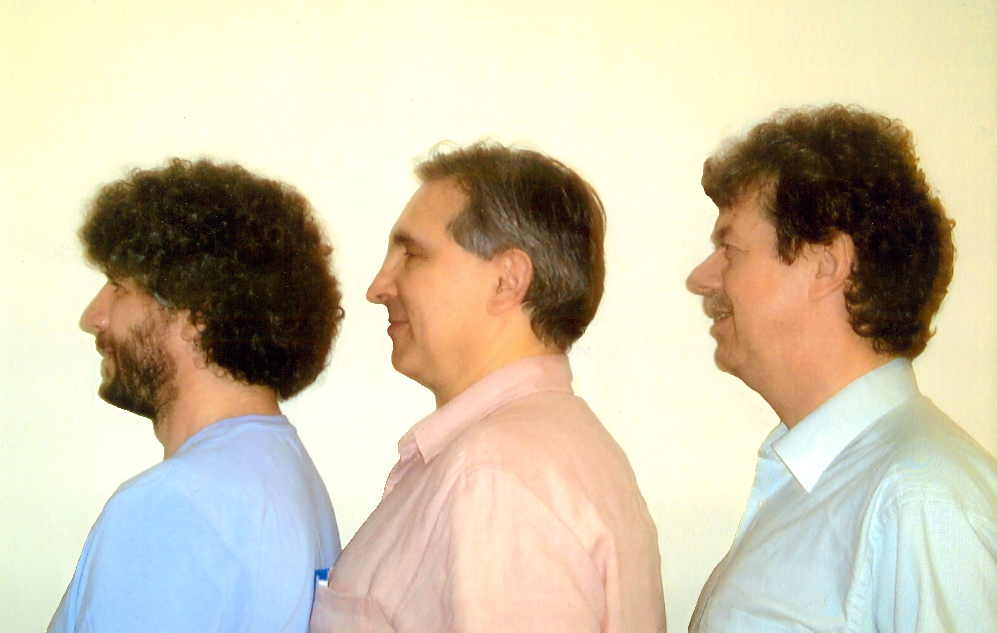
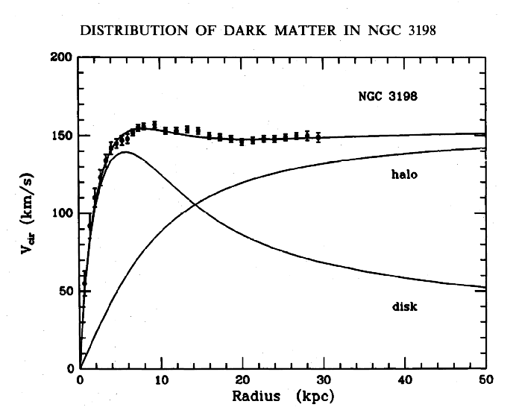
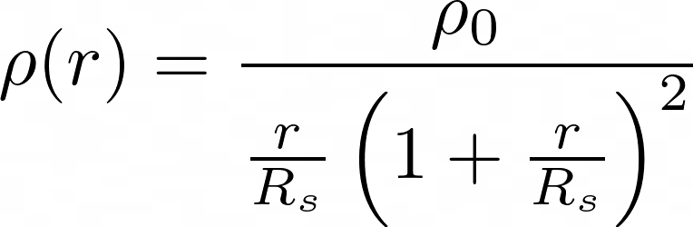

Rotation Curves : Dark Matter to the rescue
A dark matter halo engulfs the whole of our galaxy.
Dark matter interacts only via gravity.
The Rotation curve of galaxies can be accounted for if we have a dark matter halo profile given by
Navarro-Frenk-White (NFW) profile.
Julio Navarro
Carlos Frenk
Simon White
Which dictates the variation of density of the halo matter w.r.t. the distance r.
R_{s} and are fitted accordingly.

Slide 27
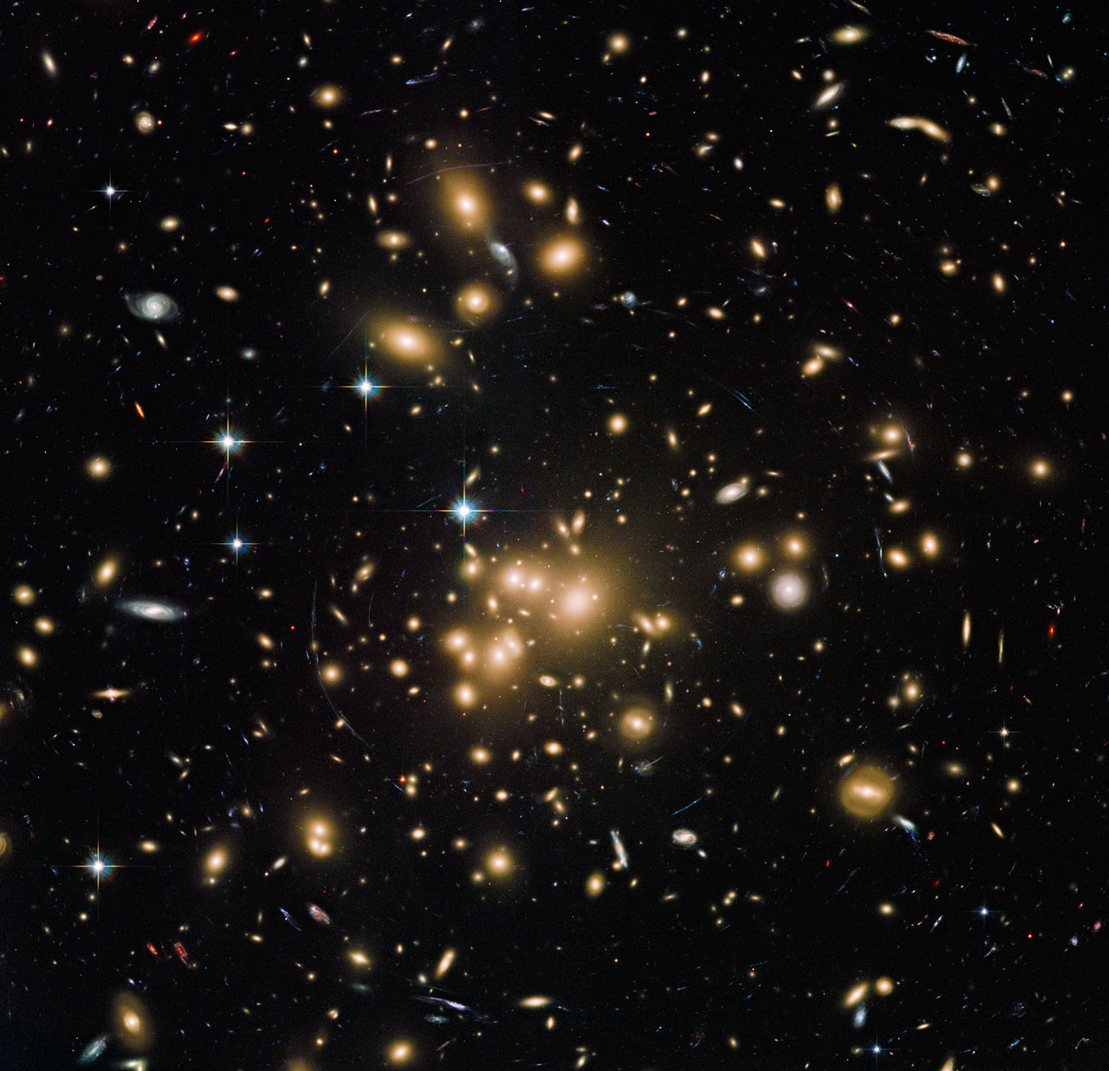
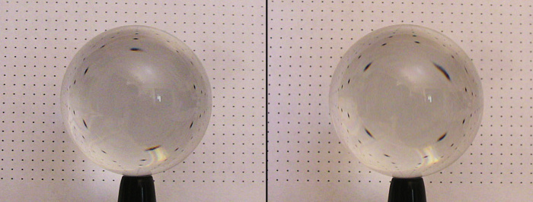
Gravitational lensing
http://www.alternativephysics.org/book/Abell1689.htm
Abell 1689
Location: In the Virgo cluster
ICRS : 13 11 31.882 -01 21 26.10
Distance: 764Mpc
Heavy Distortion in the image due to gravity
This Photo by NASA/SSU/Aurore Simonnet is licensed under CC BY-SA-NC

Slide 28
Astronomical Evidences: Rotational Curves of Spiral Galaxies

Slide 29

Image: Galaxy NGC 3198 in constellation Ursa Maior. Charts created using SkySafari 6 Pro and STScI Digitized Sky Survey. Limiting magnitudes: Constellation chart ≈ 6.5 mag, DSS2 close-ups ≈ 20 mag.

Slide 30

30

Slide 31
Evidences of Dark Matter
Evidences of Dark Matter
Astronomical Evidences
Rotational Curves of Spiral Galaxies
Gravitational Lensing
Cosmological Evidences
CMB

Slide 32
Astronomical Evidences: Gravitational Lensing

Slide 33
Gravitational Lensing: Abell 1689
Location: In the Virgo cluster
ICRS : 13 11 31.882 -01 21 26.10
Distance: 764Mpc
Heavy Distortion in the image due to gravity

Slide 34




But what is gravitational lensing?
http://www.alternativephysics.org/book/Abell1689.htm
Lensing is an important tool for Astronomy.
http://www.alternativephysics.org/book/Abell1689.htm

Slide 35

Gravitational Lensing: Abell 1689
By measuring the amount of lensing in each area element, a corresponding mass distribution can be calculated.
The blue overlay shows the mass distribution. The major contributor of this mass is dark matter.
Evidence that the cluster has an extra mass which interacts exclusively via gravity

Slide 36

Gravitational Lensing: Bullet Cluster
Location: In the Carina Constellation
ICRS : 06 58 29.6 -55 56 39
Distance: 1.141 Gpc (3.7 billion light-years)
A snapshot of two galaxy clusters colliding
Well photographed in
Visible(Hubble and Magellan Telescope at the University of Arizona),
Infrared () and
X-ray(Chandra) spectra.

Slide 37

X-RAY IN PINK
Dark Matter in Blue
Notes:
X rays represent the hot gaseous matter which does not show up in the visible spectrum. X rays are produced as a result of electronic transitions
.

Slide 38
Evidences of Dark Matter
Evidences of Dark Matter
Astronomical Evidences
Rotational Curves of Spiral Galaxies
Gravitational Lensing
Cosmological Evidences
CMB

Slide 39
Cosmological Evidence: Cosmic Microwave Background

Slide 40


CMB: Cosmic Microwave Background
This Photo by Unknown Author is licensed under CC BY-NC
Notes:
Before talking about CMB, we have to first understand the big bang theory of the origin of the universe.

Slide 41


These charged particles made the universe opaque to the early lights
Early stages of the universe: Hot Plasma soup of electrons and protons.
This early light reaches to us redshifted to microwave regime and follows the black body curve
When e and p formed hydrogen, the universe became transparent
This Photo by Unknown Author is licensed under CC BY-SA
This Photo by Unknown Author is licensed under CC BY-NC-ND

Slide 42



Cosmic Microwave Background
2.725 Kelvin
Cosmic Background Explorer (COBE)
An accidental discovery in 1965 by Arno Penzias and Robert Wilson
Has small variations depending upon the area of the sky where we look at

Slide 43

Planck Probe
Operated from 2009 to 2013
Image by Mike Peel: Model of the Planck Satellite. Photographed at the Royal Astronomical Society's National Annual Meeting 2009

Slide 44

Cosmic Microwave Background
Penzias and Wilson
COBE
Wilkinson Microwave Anisotropy Probe (WMAP)
Image: http://map.gsfc.nasa.gov/m_ig/030644/030644.html

Slide 45
Planck Probe
Anisotropy

Slide 46




Cosmic Microwave Background: Mollweide Projection

Slide 47
The CMS Detector

Slide 48
Fig : Schematic Representation of the CMS detector
Focardi, Ettore. (2012). Status of the CMS Detector. Physics Procedia. 37. 119-127. 10.1016/j.phpro.2012.02.363.

Slide 49
The CMS detector is a general-purpose detector, installed 100m underground at point 5 of LHC (near Cessy, France).
It is designed to produce:
good muon identification and momentum resolution
good charged particle momentum resolution and reconstruction efficiency
good electromagnetic energy resolution, good diphoton and dielectron mass resolution and
good missing-transverse-energy and dijet-mass resolution.
CMS uses a powerful solenoid magnet which helped to design the detector in a “compact” form.

Slide 50

Solenoid magnets
Precise measurement of charged particles over all the possible energies can be only achieved by presence of very strong magnetic field. This magnetic field is generated in the solenoid magnets of CMS detector
The solenoid magnets of the CMS utilizes a 4 layered winding made from a stable reinforced Nb-Ti conductor.
The flux is returned by a 10,000 tons Iron yoke of 5 wheels and two end caps that consist of 3 disks each.
Source: https://cms.cern/detector/identifying-tracks

Slide 51

Solenoid magnets
For a charged particle the momentum of the particle is given by $p=γmv=qBr$
where q is the charge of the particle, m is the mass of the particle and r is the bending radius of the particle.
The transverse momentum depends on both the magnetic field and the solenoid radius
$\frac{dp}{p}$ $α \frac{p}{BL^{2}}$
Where L is the path length in the magnetic field.
The solenoid magnet of CMS is a 6m diameter solenoid which produces a field of 3.8T

Slide 52

Inner tracking system
The tracker is the innermost sub-detector of the CMS. It is designed to provide a precise and efficient trajectories of all charged particles. It also helps in accurate reconstruction of secondary vertices.
The inner tracking system of CMS detector is 5.8m length and a diameter of 2.5m and surrounds the interaction point of LHC
Gumus, Kazim & Akchurin, Nural. (2023). Search For New Physics In The Compact Muon Solenoid (CMS) Experiment And The Response Of The CMS Calorimeters To Particles And Jets. 10.2172/936638.

Slide 53
Inner tracking system
At LHC there will be on average of 1000 particles from 20 overlapping p-p interactions that happens across the tracker per bunch i.e., of 25ns.
For proper detection the detector needs to have a high granularity and fast response such that the trajectories can be identified.
The inner tracking system has 2 parts
Pixel detector
Silicon strip chambers

Slide 54

Pixel Detector
This is located nearest to the interaction point and faces a very large particle flux in this region.
It tracks the interactions so precisely and provides a precise tracking points in terms of r,θ,φ directions.
The layout consist of 3 Barrel layers(BPIX) with two end cap disks (FPIX).
Karancsi, János. (2014). Operational Experience with the CMS Pixel Detector. Journal of Instrumentation. 10. 10.1088/1748-0221/10/05/C05016.

Slide 55

Pixel Detector
BPIX is 53cm long and located at the mean radii of 4.4cm, 7.3cm and 10.2cm. The two end caps (FPIX) extending from 6cm to 15cm in radius and placed at 34.5cm and 64.5cm
BPIX(FPIX) contains 48million(18million) pixels covering a total area of 0.78(0.28)$m^{2}$.
The psuedorapidity range covered is from -2.5 < η < 2.5.

Slide 56

Silicon Strip Tracker (SST)
Outside the Pixel detector the particle flux is so small hence Silicon micro strip detectors are used. The silicon strip tracker consist of 3 different sub systems
Tracker inner barrel and disks(TIB/TID).
Tracker outer barrel system(TOB)
Tracker end caps(+TEC, -TEC)
Brauer, Richard and K Klein. “The CMS Silicon Strip Tracker 2 . 1 Layout of the CMS Silicon Strip Tracker.”

Slide 57
Silicon Strip Tracker (SST)
Tracker inner barrel extends in a radius of 55 cm, and has 4 barrel layers and 3 disks at each end with a position resolution of 23μm for inner two layers and 35 μm in outer two layers.
The TIBs are surrounded by TOB which consist of 6 barrel layers with a resolution of 53 μm for first four layers and 35 μm for outer two layers. It extends up to z=118cm and beyond this range the tracker end caps takes over.
Tracker end caps provides an additional coverage up to η<2.5. Each TEC provides nine φ measurements for each trajectory and extends up to z=282cm.
In addition to first two layers of TIB/TID and TOB as well as rings 1,2 and 5 of TEC, carry a second micro-strip module with sensor in both sides with an angle of 100mrad to provide measurement of second coordinate z or r in the barrel and discs.

Slide 58


Electromagnetic Calorimeter
It is a hermitic homogenous calorimeter made of 61200 lead tungstate (PbW$O_{4}$) mounted in a central barrel part accompanied by 7324 crystals in each of two end caps. A preshower detector is installed at the face of the two end caps
Avalanche photo diodes(APDs) are used in the barrel and vacuum photo triodes (VPTs) are used in end caps
Bartoloni, Alessandro & Baccaro, S & Barone, L & Cavallari, Francesca & Dafinei, Ioan & Re, D & Diemoz, M & Marco, E & Grassi, M & Longo, E & Meridiani, Paolo & Micheli, Fiorenza & Organtini, G & Nourbakhsh, S & Paramatti, Riccardo & Pellegrino, Fabio & Rahatlou, S & Rovelli, Tiziano & Sigamani, Michael & Soffi, Livia. (2013). The CMS ECAL barrel HV system. Journal of Instrumentation. 8. C02039. 10.1088/1748-0221/8/02/C02039.

Slide 59

Electromagnetic Calorimeter
The choice of crystals are very important aspect since for precise measurements the leakage outside of the crystals should be minimized which will be minimized by choosing a high-density crystal (8.28 $g/{m^{2}}$)with small Moliere radius(2.2cm) and short radiation length (0.89cm).
The scintillation decay time is in the order of bunch crossing time i.e.., about 80% of light is emitted in 25ns.
The crystal emits blue-green scintillation light with a peak of 420-430nm.
The barrel part of ECAL covers a psuedorapidity range of |η| < 1.479
The crystals have a tapered shape, slightly varying with the position in η.
The crystals are contained in a thin-walled alveolar structure (sub module) which is 0.1mm thick and made of an aluminum layer facing the crystal and two layers of glass fiber-epoxy resin.
The end caps cover the rapidity of 1.479 < |η| < 3.0 and the longitudinal distance
between interaction point and end cap envelope is 315.4cm.

Slide 60

Hadronic Calorimeter
It consist of hadron calorimeter barrel and hadron end caps which are located outside the ECAL.
The hadron calorimeter barrel is located outside extent of ECAL (R=1.77m) and inner extent of magnetic coil(R=2.95m)
The outer hadron calorimeter or tail catcher is placed outside the solenoid contemplating barrel calorimeter. Beyond |η| = 3, the forward calorimeter (HF)is placed at 11.2m from interaction point and a psuedorapidity up to |η|=5.2
Chatrchyan, S. & Nedelec, Patrick & Sillou, Daniel & Besancon, M. & Chipaux, Remi & Dejardin, M. & Denegri, D. & Descamps, J. & Fabbro, B. & Faure, J.L. & Ferri, Frederick & Ganjour, S. & Gentit, F & Givernaud, A. & Gras, Philippe & Monchenault, G & Jarry, P & Lemaire, M & Locci, E. & Romaniuk, Ryszard. (2010). Performance of the CMS Hadron Calorimeter with Cosmic Ray Muons and LHC Beam Data. Journal of Instrumentation. 5. T03012.

Slide 61
Hadronic Calorimeter
HB consist of 36 azimuthal identical wedges covering a psuedorapidity of |η|<3 and each wedge is divided into 16 azimuthal plates, fitted in such a way that there is no projective dead material
The first and last layer is made up of stainless steel for stability and all other layers are made in brass.
The end cap sector covers 1.3 < |η|< 3.0 and uses wavelength shifting fibers as an active medium
These light is then analyzed by hybrid photo diodes(HPDs).

Slide 62
The Muon System
The CMS Muon system is designed to provide a good muon identification and momentum resolution with good trigger capabilities.
The muon system is made to work in the range : |η| < 2.4
The detectors are placed in between the return yoke which provides magnetic field to the detectors and also stop hadrons.
The Muon System comprises of : 4 layers of Drift tubes , end cap cathode strip chambers and resistive plate chambers.
The Drift tubes are composed of drift tube cells filled with 85% Argon and 15% CO2.
Each DT chamber is made of two or three super-layers(SL) where each super-layer is made of four layers of drift cells staggered by half a cell.
Cathode Strip Chambers, installed at the endcaps, are multi-wire proportional chambers consisting of six planes of anode wires interleaved among seven cathode panels.
Resistive Plate Chambers (RPC) are gaseous parallel plate detectors. They provide a very fast response time, required for efficient triggering.

Slide 63

The Muon System
Kalinowski, Artur & Krolikowski, Jan. (2023). Search for the heavy, neutral MSSM Higgs particles in the $H/A -> \tau \tau -> \mu + X$ channel in the CMS detector at the LHC.

Slide 64
The Trigger System and Data Acquisition

Slide 65

LHC produces a large interaction rates (Bunch crossing rate: 40 MHz)
Each recorded event has a size around 1 MB; This makes it impossible to store all the data from the pp collisions at the designed bunch crossing rate.
The Trigger system, is designed to select the best events from the collisions in real time.
The Trigger Systems consists of : Level 1 trigger (L1 Trigger) and High Level Trigger(HLT).

Slide 66

L1 Trigger
The Level 1 trigger is a hardware based processing system which employs the use of programmable electronics like FPGAs extensively.
The L1 trigger reduces the input crossing rate of 40MHz to an output rate of 100KHz.
The L1 trigger follows a hierarchy as shown in the figure. The Global Trigger takes input from two , subsystems: Calorimeter trigger and Muon trigger system.
The raw data from detector elements first reaches the “trigger primitives”. These are represented in the top of the diagram.
The regional detectors combine the information from trigger primitives to create ranked objects. For example, an e/γ candidate has deposits energy in narrow η . The RCT identifies and sorts such objects.

Slide 67

L1 Trigger
The Global Calorimeter and Global Muon Trigger, sort the trigger objects from Regional Triggers into a ranking and feed to the Global Trigger.
The Global Trigger takes the topology of the detector and other factors into consideration. It takes into account, various physics criteria to make a decision to keep an event or not.

Slide 68

High Level Trigger
HLT is a software based processing system which employs commercial microprocessor based farms for trigger. The trigger farm is composed of about 2000 PCs.
HLT takes information from L1 at 100 kHz and makes selections to produce a final rate of about 800Hz.
HLT is much slower than L1 and has to account for possible failures of computing nodes.
HLT builds one full event from the event fragments it gets as input.
HLT is also responsible for Jet Reconstruction.
An HLT rack

Slide 69
References
1.V. Khachatryan, et al. "The CMS trigger system". Journal of Instrumentation 12. 01(2017): P01020–P01020.
2. Collaboration, SMS & Warsaw, CMS & Pozniak, Krzysztof & Romaniuk, Ryszard & Zabolotny, Wojciech. (2010). Commissioning of CMS HLT. Journal of Instrumentation. 5. T03005. 10.1088/1748-0221/5/03/T03005.
3. Brooke, James & Cussans, David & Frazier, Ricky & Heath, G & Machin, D & Newbold, D & Galagadera, S & Madani, Sadaf & Shah, Abid. (2023). Hardware and Firmware for the CMS Global Calorimeter Trigger.
4. Manfred Jeitler on https://cms.cern/news/real-time-analysis-cms-level-1-trigger
5. Nil Valls on http://www.nilvalls.com/compact-muon-solenoid-up-close-and-personal/
6. Search of Large Extra Dimensions in final state in pp collisions with the CMS Detector at the LHC, Dr. Bhawna Gomber

